Slide 1
1979 Abbotsford Landslide
CE EN 544
Prepared for: Dr. Jones

Slide 2
Abbotsford Landslide Location

Slide 3
Landslide Overview
Subtle movement initiated a few weeks before
Roughly 5 million m³ (176.6 million ft³)
69 houses destroyed
Roughly $7.5 million USD in damages
No loss of life caused

Slide 7
Possible Cause 1: Site Geology
Notes:
Geological map of the Abbotsford area of southwest Dunedin, showing locations of the Abbotsford Landslide and several other landslides in the area. Thick surficial deposits of loess and bouldery colluvium (not shown) are widespread in most places overlying the Tertiary sedimentary rocks. b Cross-section A–B shows the topography and geological structure in relation to the Abbotsford Landslide

Slide 8
Possible Cause 2: Increased Pore Water Pressure
Major Factor : Rainfall
Notes:
Graph of annual rainfall from 1917 to 1978 in the Dunedin suburbs of Burnside (approximately 1.5 km east of the landslide) and Musselburgh (approximately 7 km east). The plots show long-term mean annual rainfall and cumulative deviation from the mean in both of these areas. Mean rainfall at Green Island is also shown for 1969–1978. (Based on data from the NZ Metrological Service)

Slide 9
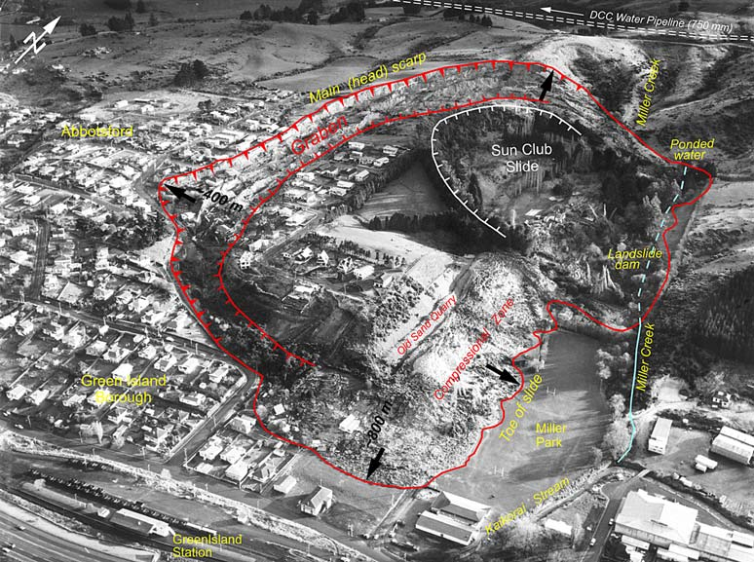
Possible Cause 2: Increased Pore Water Pressure
Major Factor : Leaking Main
Notes:
Graph of annual rainfall from 1917 to 1978 in the Dunedin suburbs of Burnside (approximately 1.5 km east of the landslide) and Musselburgh (approximately 7 km east). The plots show long-term mean annual rainfall and cumulative deviation from the mean in both of these areas. Mean rainfall at Green Island is also shown for 1969–1978. (Based on data from the NZ Metrological Service)

Slide 10
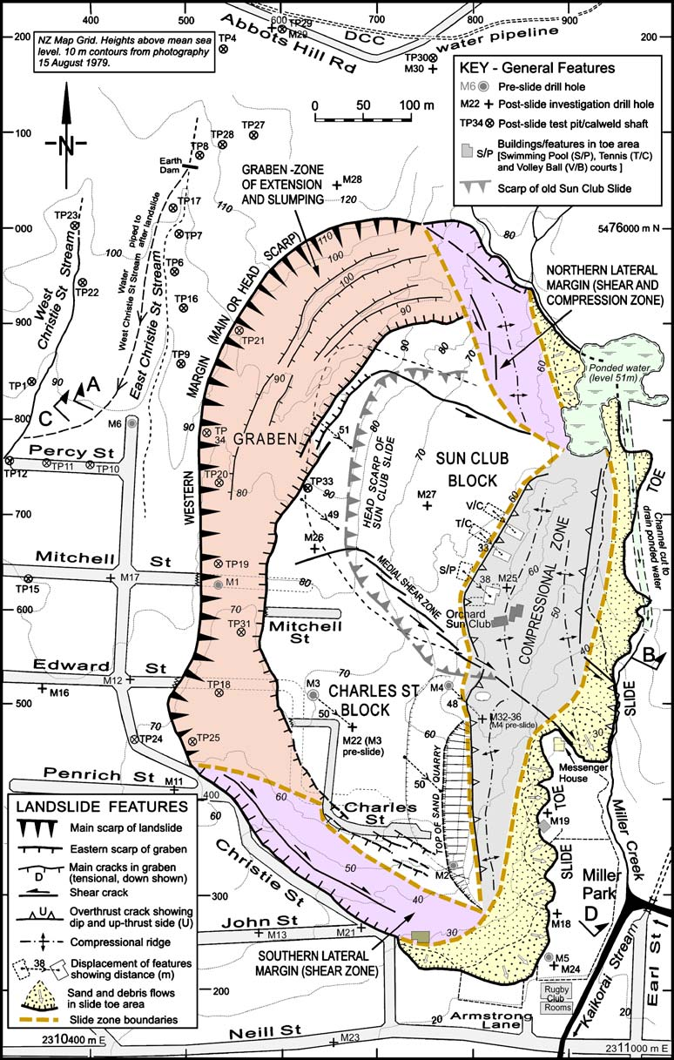

Slide 11
Steady Decline over the Years

Slide 12
Analysis Summary
Typical Block Land slide with translational failure on thin, low-angle clay layers located within the top meter of the Abbotsford Formation
Unfavorable geology and topography – very week clay near an eroding creek
Increased pore water pressure – Increased Rainfall and Leaking Main(3 years)
Quarrying of sand at the toe of the slope - 6% of the slide mass
Minor Factors
Removal of natural vegetation
Urban Development
Past Sesmic Activity

